Slide 1



A Deuteration Survey of Dense Prestellar Cores in Taurus
Hanga Andras-Letanovszky
Mentor: Yancy Shirley, University of Arizona Department of Astronomy / Steward Observatory
Arizona Space Grant Symposium, Arizona State University, April 22, 2023

Slide 2
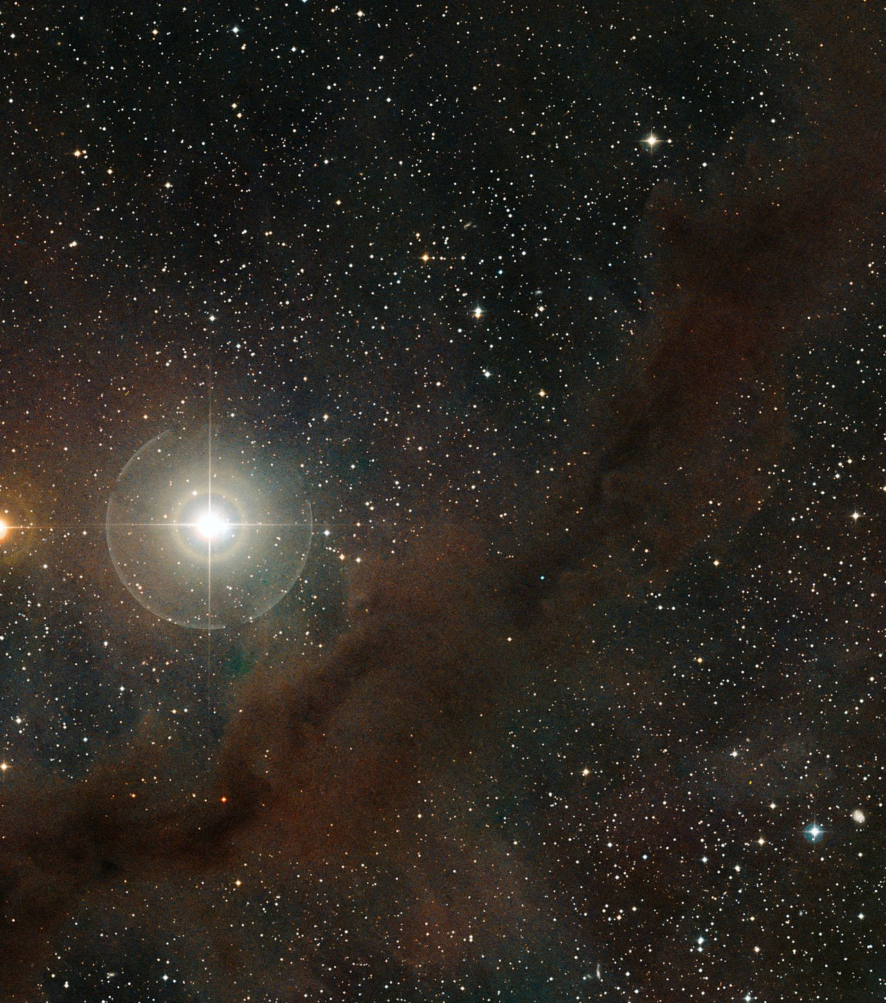

Prestellar Cores
Dense, cold clumps of gas and dust
  A few Kelvin above 2.73 K (temperature of the Cosmic Microwave Background)
  Located in large molecular clouds
Can eventually gravitationally collapse into a protostar
  Determines the initial conditions for planet-forming disk
This process isn’t well understood
Image Credit: European Southern Observatory

Slide 3
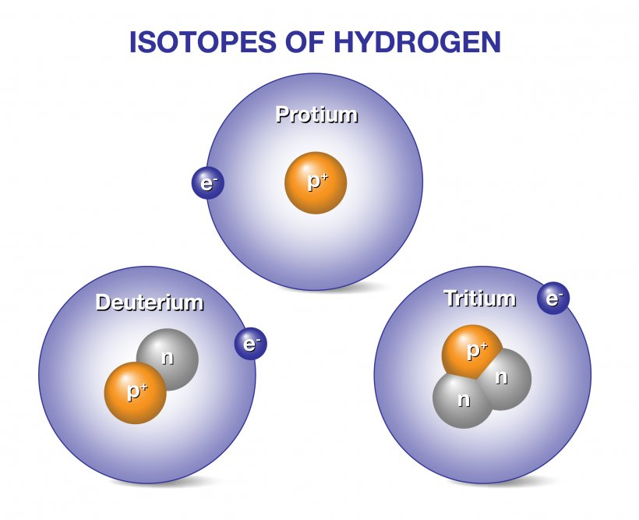
Deuteration
Hydrogen isotope with an extra neutron
Sometimes a regular hydrogen gets replaced with a deuterium atom
This process occurs more frequently in cold, dense environments
  Occurs either on icy grain surfaces or in the gas phase
Image Credit: General Atomics

Slide 4
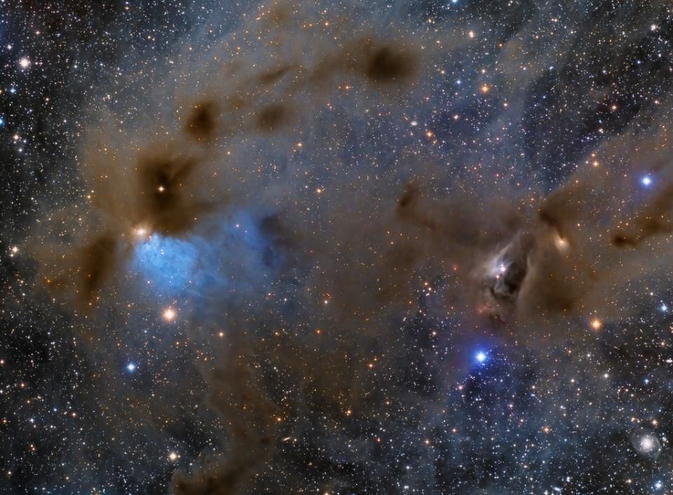
Deuteration
Deuterated molecules build up in prestellar cores over time
  Older cores tend to have higher ratios of deuterated to nondeuterated molecules
Can compare deuteration ratios to core densities to get a relative estimate of core age
  Better understand core evolution rates and thus star formation
Image Credit: Lloyd L. Smith, Deep Sky West

Slide 5
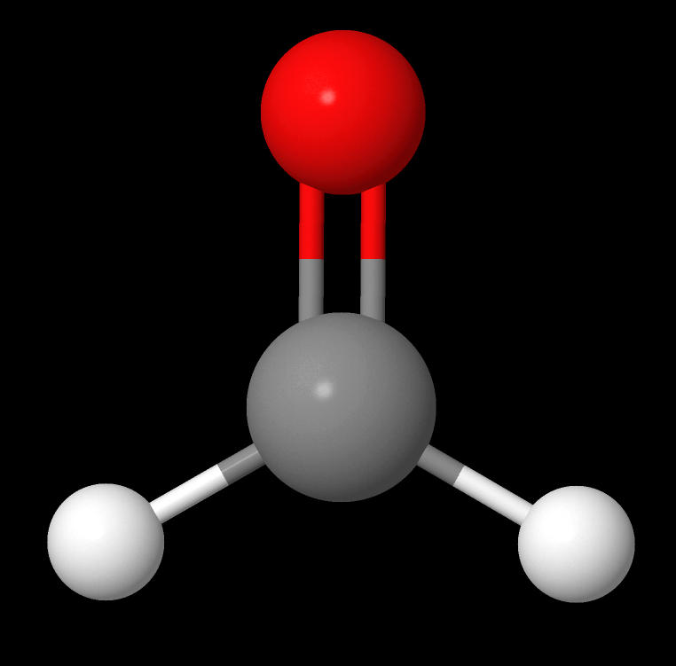
Objective
1.2mm Continuum Emission of B10
Get ratios of HDCO/ H₂CO (formaldehyde) of 12 cores in the Barnard 10 (B10) region of Taurus
  H₂CO thought to deuterate primarily on icy grain surfaces
Estimate their ages, compare to chemical models to get evolution rates
Compare properties to find interesting trends
Image Credit: Kinetic Database for Astrochemistry

Slide 6
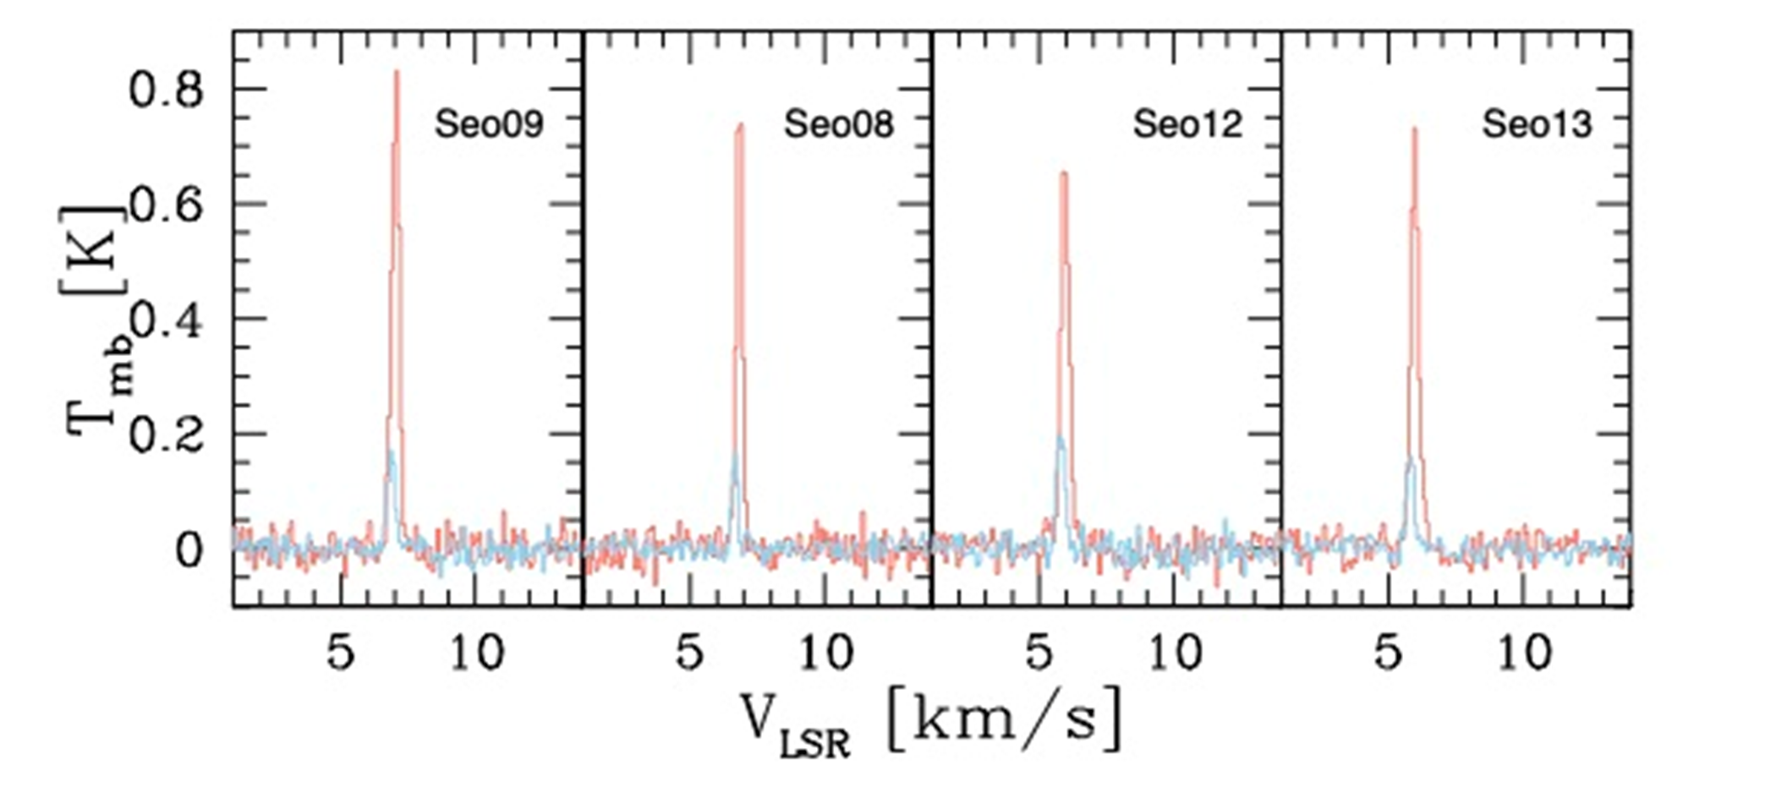
Methodology
Started with previously taken spectra of the 128 GHz and 134 GHz rotational transitions of HDCO
  Every time a molecule changes the way it rotates, it releases a photon corresponding to its change in energy
  We can detect these photons and make a spectra of them
  All 12 detected in 128 GHz, initially only 8 in 134 GHz
128 GHz (orange) & 134 GHz (blue) HDCO Emission Lines

Slide 7
Methodology
We want column densities and excitation temperatures
Column density is how many molecules there are in volume collapsed into an area
Excitation temperature is the temperature that describes the energy distribution of the molecules

Slide 8
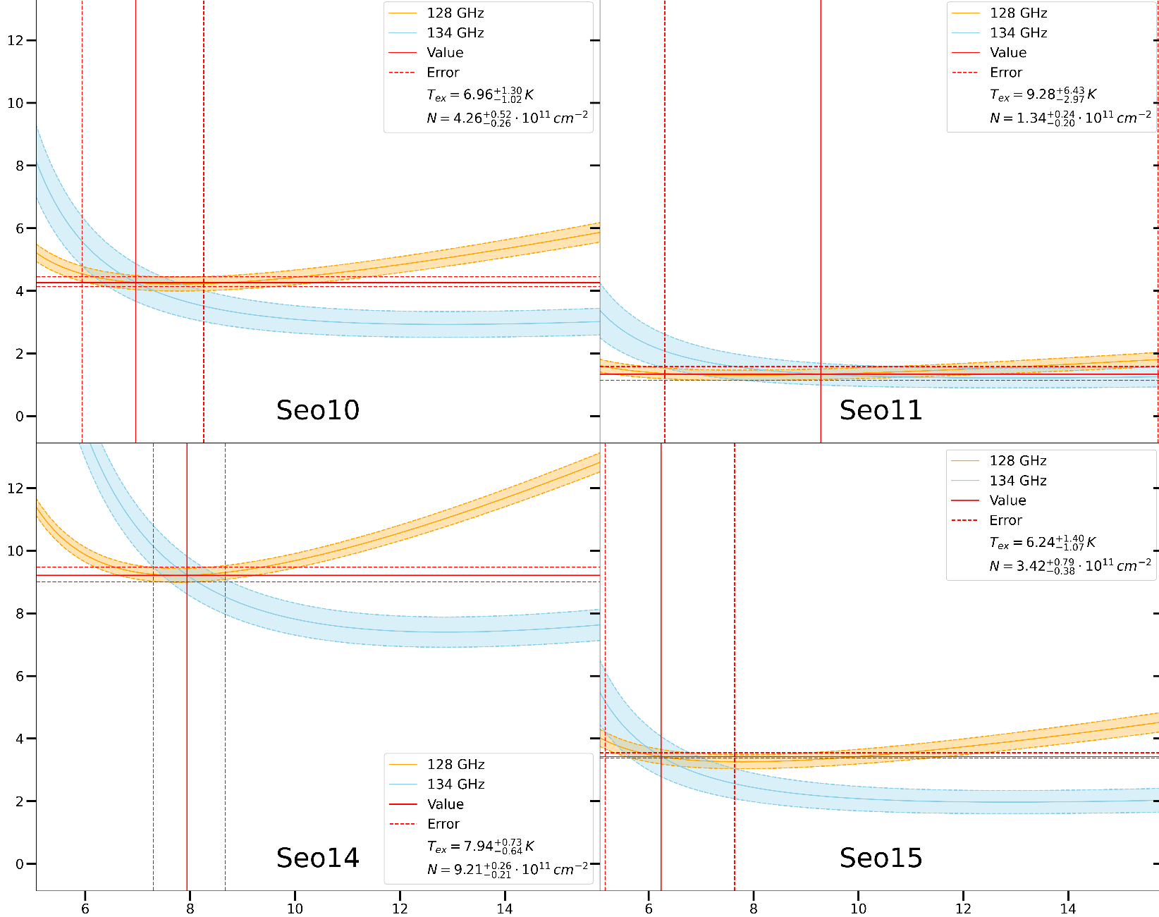
Methodology
Column Density and Excitation Temperature Calculation for Selected Cores
Got column density and excitation temperature of HDCO for each core
  Optically thin, so we could use directly compare curves for both lines
    Curves based on intensity of HDCO in that line
  Intersection of curves gave column density, excitation temperature, and their errors
N (10¹¹ cm⁻²)
T_{ex} (K)

Slide 9
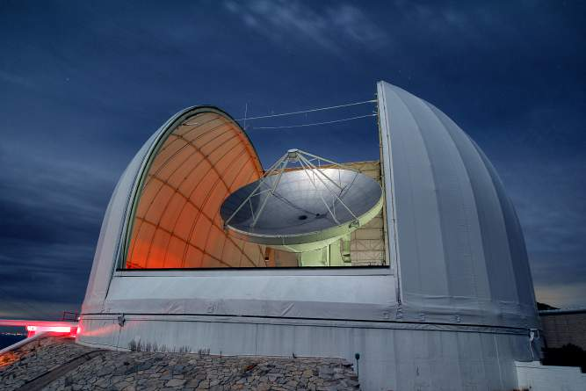
Methodology
We later got time on the 12m radio telescope on Kitt Peak
Got detections for the 134 GHz line for the remaining 4 cores
Image Credit: Arizona Radio Observatory

Slide 10
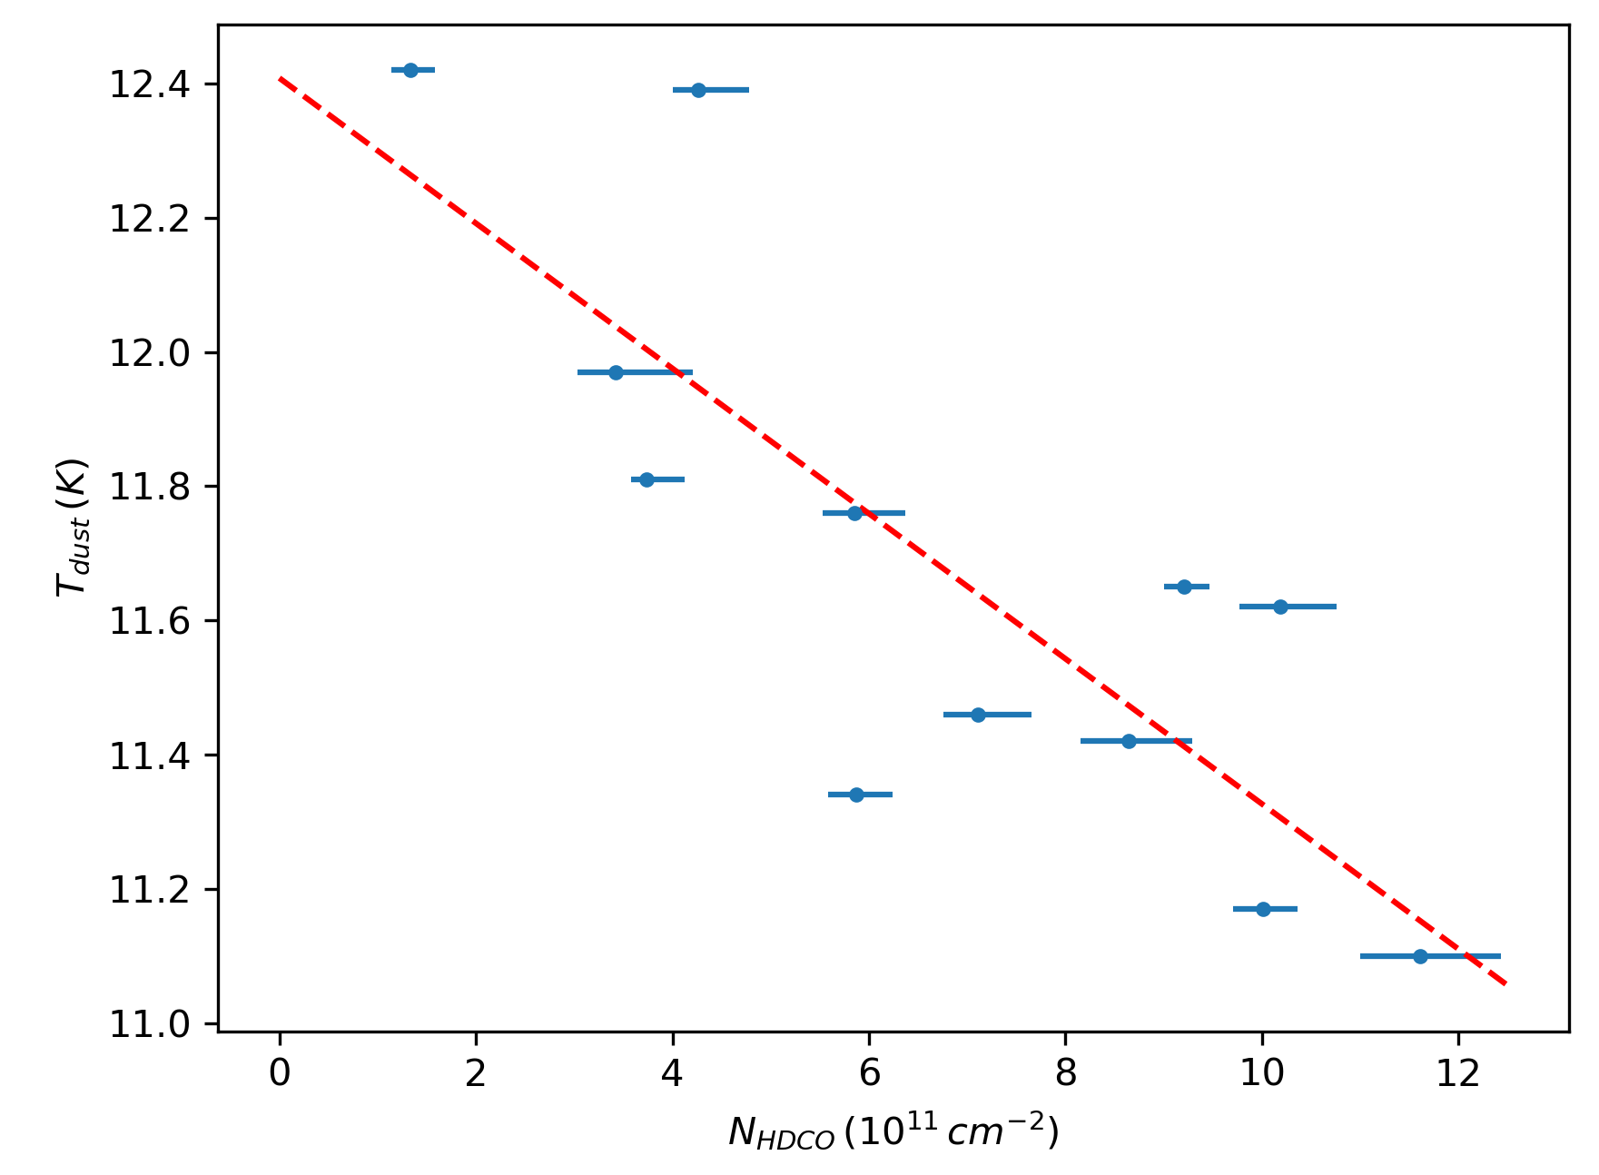
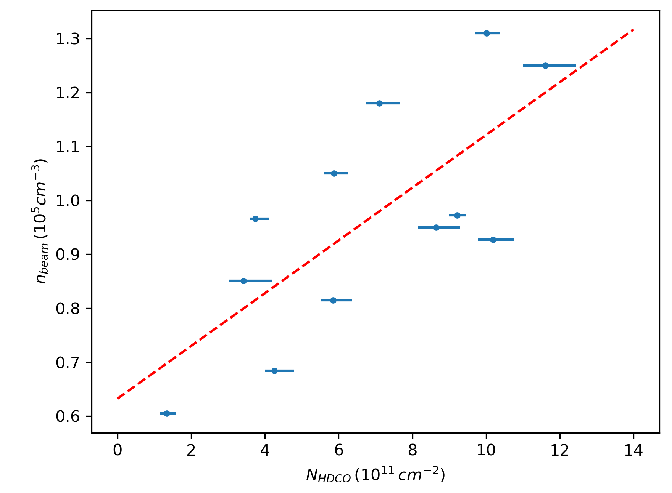
Results
T_{dust} vs. N_{HDCO}
Graph of HDCO column density vs. average core density and dust temperature
Shows that colder, denser cores have a higher rate of deuteration – makes sense
n_{beam} vs. N_{HDCO}

Slide 11
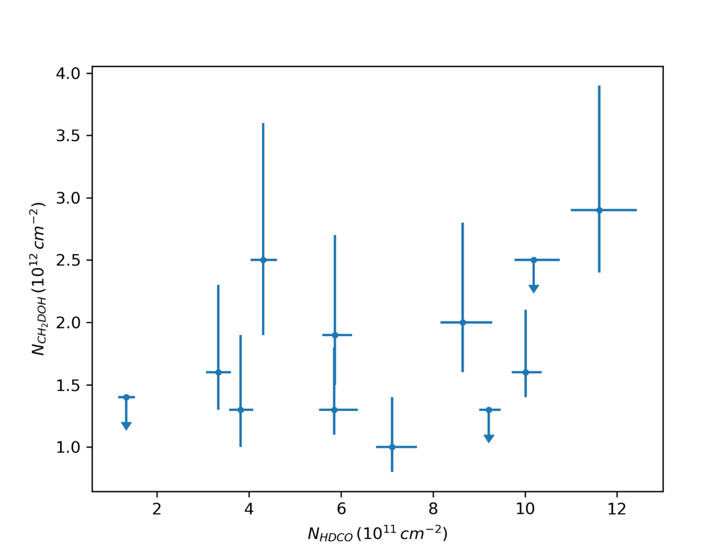
Results
N_{CH2DOH} vs. N_{HDCO}
Graph of HDCO vs CH₂DOH column density, no significant correlation
Strange because both molecules thought to deuterate on icy grain surfaces
Indicates that H₂CO deuteration may have a gas phase contribution

Slide 12
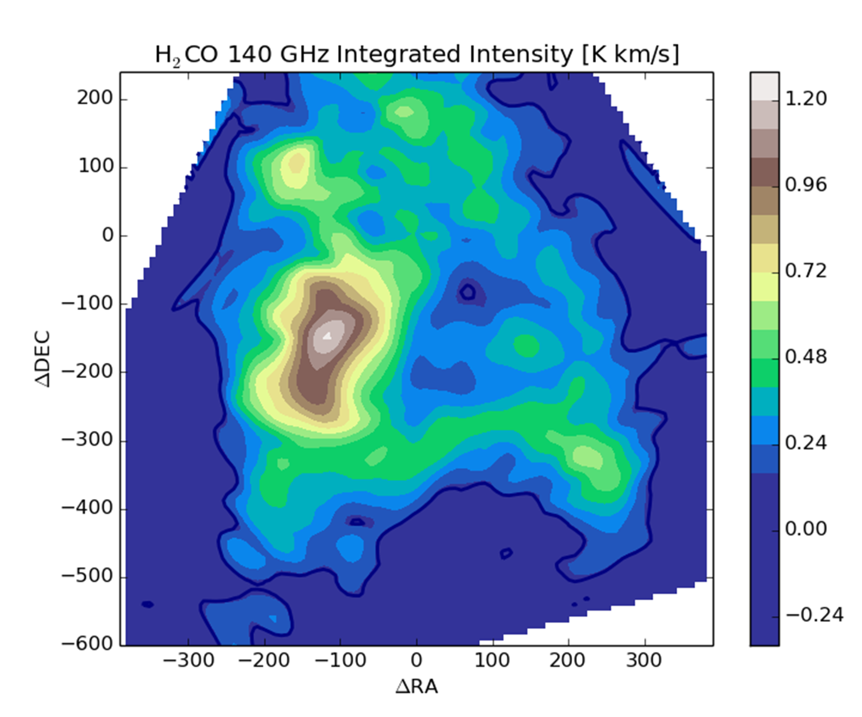
Next Steps
Use a previously made map of B10 in H₂CO to get H₂CO column densities and calculate the deuterium fractions of all the cores
Map B10 in the 128 GHz line of HDCO its distribution with N₂D⁺ which exclusively deuterates via gas phase reactions

Slide 13
Acknowledgements
Dr. Yancy Shirley, University of Arizona Department of Astronomy / Steward Observatory
Samantha Scibelli, University of Arizona Department of Astronomy / Steward Observatory
Michelle Coe and Dr. Chandra Holifield Collins, Arizona Space Grant Consortium
Reynier Squillace, Jacob Blais, and Shae Henley, Arizona Space Grant Consortium
Arizona Space Grant Consortium
NASA
University of Arizona
Arizona Radio Observatory

Slide 14
Thank you!

